Slide 1
Assessment of the Domestic Perception of Armenian Pharmaceutical Products
Presentation
September 2008

Slide 2
Content
Introduction
Chapter 1 - Consumer Profile
Chapter 2 - Respondents’ Awareness
Chapter 3 - Respondents’ Perception
Chapter 4 - Respondents’ Behavior
Chapter 5 - Conclusions and Recommendations

Slide 3
Introduction

Slide 4
Assessment of the Domestic Perception of Armenian Pharmaceutical Products Assessment Implementation
Initiated by
USAID CAPS Project
Implemented by
AM PARTNERS Consulting Company
Period
April-July 2008

Slide 5
Assessment of the Domestic Perception of Armenian Pharmaceutical Products The Cluster of Health Care
Regulating authority Ministry of Health of RA
Educational institutions > 10
Newspapers and magazines ~ 20
Health care NGOs > 20
Charitable organizations ~ 10
61 licensed importers 61
Distributors > 20
Producers 17
State and private clinics 751
Pharmacies 1105

Slide 6
Assessment of the Domestic Perception of Armenian Pharmaceutical Products Assessment Objectives and Objects
Assessment
OBJECTIVES
Assessment
OBJECTS
Assessment of the consumers’ awareness level about the Armenian pharmaceuticals
Assessment of the consumers’ perception towards the Armenian pharmaceuticals
Assessment and presentation of consumers (buyers’) behavior peculiarities
Consumers
Procurers at clinics
Physicians
Pharmacy managers
Pharmacists

Slide 7
Assessment of the Domestic Perception of Armenian Pharmaceutical Products Assessment Sampling and Geography
Assessment
Sampling
Assessment
geography

Slide 8
Consumer Profile
Chapter 1

Slide 9
Assessment of the Domestic Perception of Armenian Pharmaceutical Products Consumers’ profile
COMPARISON
Yerevan vs. Marzes
------------------------------------------------------
53% (205 persons) of respondent consumers were from Yerevan, 47% (179 persons) of respondent consumers were from Marzes (regions)
57% of respondents from Yerevan have had higher education, 27% - secondary education
31% of respondents from Marzes have had higher education, 45% - secondary education

Slide 10
Assessment of the Domestic Perception of Armenian Pharmaceutical Products Consumers’ profile
Consumers’
PROFESSIONS
Consumers’
ENGAGEMENT

Slide 11
Assessment of the Domestic Perception of Armenian Pharmaceutical Products Consumers’ profile

Slide 12
Assessment of the Domestic Perception of Armenian Pharmaceutical Products The profile of clinics and their representatives
74 assessed clinics, including 41 (55%) state entities and 33 (45%) private entities
------------------------------------------------------------------------------------------------------------------------------------------------------------------------
Ways of pharmaceuticals’ procurement
43% of clinics procure the major part of pharmaceuticals through the system of government purchases.
50% of clinics procure all pharmaceuticals through direct purchases. These are private entities.
Sources of pharmaceuticals’ procurement
73% of clinics procure the major part of pharmaceuticals from importers.
82% of clinics do not procure pharmaceuticals from producers.
99% of clinics do not import pharmaceuticals.
85% of clinics do not procure pharmaceuticals from pharmacies.

Slide 13
Assessment of the Domestic Perception of Armenian Pharmaceutical Products The profile of clinics and their representatives
2. Procurers of pharmaceuticals at clinics

Slide 14
Assessment of the Domestic Perception of Armenian Pharmaceutical Products The profile of clinics and their representatives
3. Physicians

Slide 15
Assessment of the Domestic Perception of Armenian Pharmaceutical Products The profile of pharmacies
85 assessed pharmacies. 9.4% of them are included in pharmacy networks

Slide 16
Assessment of the Domestic Perception of Armenian Pharmaceutical Products The profile of pharmacies
4. Pharmacy managers

Slide 17
Assessment of the Domestic Perception of Armenian Pharmaceutical Products The profile of pharmacies
5. Pharmacists

Slide 18
Chapter 2
Respondents’
Awareness

Slide 19
Assessment of the Domestic Perception of Armenian Pharmaceutical Products Awareness - Armenian Pharmaceutical Production
1. Consumers
23% of consumers know at least 1 Armenian pharmaceutical. Meantime, 77% of consumers could not name any pharmaceutical.
So-called “aware” consumers named 173 types of products.
Among consumers those types of pharmaceuticals, which are mostly available in any house are most popularity is taken by. These are mainly pharmaceuticals normally used without physician’s prescription or for the first medical aid

Slide 20
Assessment of the Domestic Perception of Armenian Pharmaceutical Products Awareness - Armenian Pharmaceutical Production
3. Physicians
96% of physicians are aware of at least 1 Armenian pharmaceutical.
1 physician knows names of 4.6 pharmaceuticals on average.
Dentists are not usually aware of Armenian pharmaceuticals.
Pharmaceuticals familiar to physicians are produced…
- 24% - by Liqvor;
- 19% - by Arpimed;
- 10% - by Yerevan CPF.

Slide 21
Assessment of the Domestic Perception of Armenian Pharmaceutical Products Awareness - Armenian Pharmaceutical Production
5. Pharmacists
All pharmacists know more than 10 Armenian pharmaceuticals.
The awareness high level of pharmacists is conditioned by their professional responsibilities. They have to know names of pharmaceuticals that they sell everyday.
Pharmaceuticals familiar to physicians are produced…
- 39% - by Arpimed;
- 19% - by Esculap;
- 16% - by Liqvor.

Slide 22
Assessment of the Domestic Perception of Armenian Pharmaceutical Products Sources of information - Armenian pharmaceutical production

Slide 23
Assessment of the Domestic Perception of Armenian Pharmaceutical Products Awareness – Armenian Producers
1. Consumers
Only 11 out of 384 respondents were able to recall any Armenian producer of pharmaceuticals without an aid.
Those 11 respondents together named only 7 Armenian producers of pharmaceuticals.
Additional 25 consumer respondents recalled 1-2 more producers after the aid. Others know no Armenian producer of pharmaceuticals.
Even if some consumer respondents know any producer of pharmaceuticals, they don’t know the types of pharmaceuticals they manufacture.

Slide 24
Assessment of the Domestic Perception of Armenian Pharmaceutical Products Awareness – Armenian Producers
2. Procurers of pharmaceuticals at clinics
3. Physicians

Slide 25
Assessment of the Domestic Perception of Armenian Pharmaceutical Products Awareness – Armenian Producers
4. Pharmacy managers
5. Pharmacists

Slide 26
Assessment of the Domestic Perception of Armenian Pharmaceutical Products Sources of information - Armenian Producers
3 main sources of information on Armenian pharmaceuticals producers among consumers
Only 10% of consumers could tell the source of the information about Armenian producers of pharmaceuticals.
The link between producers and consumers in the market of pharmaceuticals is very weak, or even does not exist at all.

Slide 27
Assessment of the Domestic Perception of Armenian Pharmaceutical Products Sources of information - Armenian Producers
3 main sources of information on Armenian pharmaceutical producers among procurers of pharmaceuticals at clinics

Slide 28
Assessment of the Domestic Perception of Armenian Pharmaceutical Products Sources of information - Armenian Producers
3 main sources of information on Armenian pharmaceutical producers among physicians

Slide 29
Assessment of the Domestic Perception of Armenian Pharmaceutical Products Sources of information - Armenian Producers
3 main sources of information on Armenian pharmaceutical producers among pharmacy managers

Slide 30
Assessment of the Domestic Perception of Armenian Pharmaceutical Products Sources of information - Armenian Producers
3 main sources of information on Armenian pharmaceutical producers among pharmacists

Slide 31
Chapter 3
Respondents’
Perception

Slide 32
Assessment of the Domestic Perception of Armenian Pharmaceutical Products Perception Consumers’ experience in using Armenian pharmaceuticals
Respondents experience in use of pharmaceuticals could be considered as the most objective basis for the formation of respondents’ perception
Frequency of consumers’ visits to pharmacies during January-April 2008
Quantity of pharmaceuticals bought per purchase

Slide 33
Assessment of the Domestic Perception of Armenian Pharmaceutical Products Perception Consumers’ experience in using Armenian pharmaceuticals
36% of respondents visited pharmacies only once during last 4 months, and 29%- 2-5 times These people cannot be considered as quite experienced in buying pharmaceuticals.
This fact decreases their opportunities of getting information about Armenian pharmaceuticals. This means, it will be very difficult for unaware consumer to judge objectively about Armenian pharmaceuticals.
53% of consumers does not know whether they have ever purchased Armenian pharmaceuticals. Another 21% declared that never purchased Armenian pharmaceuticals. This means that only 26% of consumers have real (conscious) experience o f consuming Armenian pharmaceuticals.
Consumers form their perception towards Armenian pharmaceuticals based on opinions and advice of friends, relatives, physicians, pharmacists, instead of basing on their own experience.

Slide 34
Assessment of the Domestic Perception of Armenian Pharmaceutical Products Perception Practices of purchasing the Armenian pharmaceuticals at clinics
2. Procurers of pharmaceuticals at clinics
84% of Procurers at clinics declared their purchases of Armenian pharmaceuticals for the needs of their entity.
The majority of procured Armenian pharmaceuticals are products of Liqvor, PharmaTech, and Arpimed.
Dental clinics comprise the majority of entities that are not purchasing Armenian pharmaceuticals, at all.
3. Physicians
84% of physicians declared, that they use or prescribe Armenian pharmaceuticals in their practice.
The most demanded pharmaceuticals are infusion solutions, antibiotics, lidokayin, and vitamin complexes.
The number of physicians that do not trust to Armenian pharmaceuticals prevails, although in many cases there is no reason for that distrust.

Slide 35
Assessment of the Domestic Perception of Armenian Pharmaceutical Products Perception Practices of purchasing the Armenian pharmaceuticals at pharmacies
There is no pharmacy in Armenia that did not or currently does not sell Armenian pharmaceuticals
In case of pharmacies one may notice the approach applied by commercial entities: “the larger the nomenclature and opportunities for choice, the more clients and attendance”
Top 5 Armenian pharmaceuticals purchased by pharmacy managers for selling at the pharmacy
Top 5 Armenian pharmaceuticals sold by pharmacists

Slide 36
Assessment of the Domestic Perception of Armenian Pharmaceutical Products Perception / The importance of pharmaceuticals’ origin
1. Consumers
Low level of their awareness does not allow consumers make sound/justified inferences.
Consumers that have formed preferences usually prefer imported pharmaceuticals
Consumers who usually prefer imported pharmaceuticals justify their choice with following main reasons:
Imported pharmaceuticals are more trustful and of higher quality;
Imported pharmaceuticals are more efficient;
Reliability of imported pharmaceuticals is proven by the experience.

Slide 37
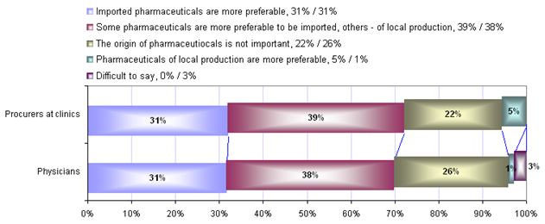
Assessment of the Domestic Perception of Armenian Pharmaceutical Products
PERCEPTION - Importance of the origin
2/3. Representatives of clinics
Those representatives of clinics who prefer imported pharmaceuticals (31%) tell that:
Imported pharmaceuticals are of much better quality and are more efficient than Armenian pharmaceuticals
Their devotion towards imported pharmaceuticals the representatives of clinics justify by the following reason:
They have no right to make experiments on patients’ health and prescribe inefficient Armenian pharmaceuticals, providing the availability of high quality imported pharmaceuticals

Slide 38
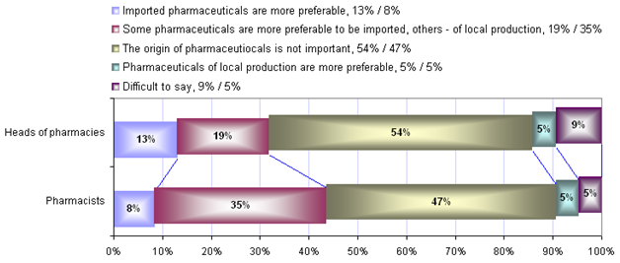
Assessment of the Domestic Perception of Armenian Pharmaceutical Products
PERCEPTION - Importance of the origin
4/5. Pharmacists
Pharmacists are evaluating the importance of the origin of pharmaceuticals from not only professional viewpoint, but also from the commercial aspect.
For the 54% of pharmacists the origin of pharmaceuticals does not matter. They prefer such factors as liquidity, demand and sales volumes of pharmaceuticals.
5% of pharmacists prefer Armenian pharmaceuticals due to patriotic feelings. These pharmacists would like to promote Armenian product and assist the Armenian producer, since their development will contribute the development of the Armenian economy.

Slide 39
Assessment of the Domestic Perception of Armenian Pharmaceutical Products PERCEPTION - quality, price, packaging, availability
Ranking tool
Share of non-relies (those who could not estimate/rank)

Slide 40
Assessment of the Domestic Perception of Armenian Pharmaceutical Products PERCEPTION - quality, price, packaging, availability
1. Consumers
Consumers who were able to make comparative ranking:
36% of respondents relied on their own experience;
24% of respondents made ranking based on advice of their friends and relatives;
17% of respondents made ranking based the impression received from various medical and promotional TV programs
11% of respondents made ranking based advice of physicians and pharmacists
Other respondents were not able clearly note the bases of their ranking

Slide 41
Assessment of the Domestic Perception of Armenian Pharmaceutical Products PERCEPTION - quality, price, packaging, availability
2. Procurers at clinics
3. Physicians

Slide 42
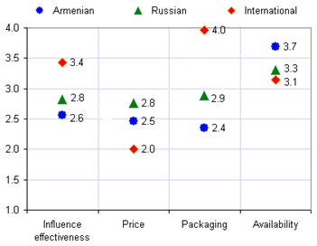
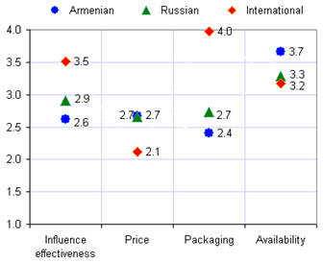
Assessment of the Domestic Perception of Armenian Pharmaceutical Products
PERCEPTION - quality, price, packaging, availability
4. Pharmacy managers
5. Pharmacists

Slide 43
Assessment of the Domestic Perception of Armenian Pharmaceutical Products Perception - Values of different characteristics
2. Procurers at clinics

Slide 44
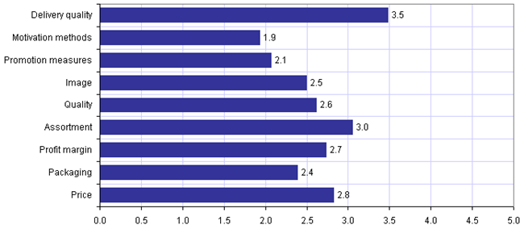
Assessment of the Domestic Perception of Armenian Pharmaceutical Products
Perception - Values of different characteristics
4. Pharmacy managers

Slide 45
Chapter 4
Consumers’
Behavior

Slide 46
Assessment of the Domestic Perception of Armenian Pharmaceutical Products Behavior - Consumers
Sooner or later each consumer has to buy pharmaceuticals (frequently or rarely), there is always a second agent (individual), who usually gives advice.
independently from whose and which kind of advices are used by consumers to make a decision on purchasing pharmaceuticals, there is a group of people whose advice or opinion has exceptional importance and meaning for consumers. These people are physicians.
Groups of advisors that direct consumers’ purchase of pharmaceuticals

Slide 47
Assessment of the Domestic Perception of Armenian Pharmaceutical Products Behavior - Consumers
The most important factor affecting the consumers’ decision is the physicians’ guarantee (advice).
Physicians do know about this propensity towards their advice and usually get benefits from that.
34% of consumers stated that they had situations when physicians prescribed a medication and “advised” that “the pharmaceuticals of particular producer or particular origin must be bought” . 5% of consumers always and 39% - very often face this kind of situations.
Factors affecting the decision of purchasing pharmaceuticals and their importance
Explanation of ranks
3 - very important
2 - important
1 - unimportant

Slide 48
Assessment of the Domestic Perception of Armenian Pharmaceutical Products Behavior - Consumers
How consumers deal with these situations?
What consumers do when they do not find the prescribed pharmaceuticals at pharmacy?
88% of them follow physicians’ advice;
5% is getting upset and consults with other physicians;
3% also consults pharmacists and other specialists;
Others do not have clear behavior.
83% try to find the pharmaceuticals in other pharmacies, or contact other individuals, even relatives that live abroad;
14% of consumers are inclined to substitute the prescribed pharmaceuticals with analogues.

Slide 49
Assessment of the Domestic Perception of Armenian Pharmaceutical Products Behavior - Representatives of clinics
93% of officials responsible for purchase of pharmaceuticals at clinics state that none of the institution managers interfere the process of fulfilling professional duties by physicians.
At clinics physicians have such freedom of actions, which automatically makes them one of the most important players in the process of pharmaceuticals circulation within and out of clinics.
Many participants of the pharmaceuticals market, including producers, confirmed that at clinics cases of “cooperation” between suppliers of pharmaceuticals and physicians is very common. Physicians are motivated by suppliers of pharmaceuticals to write prescriptions and give advice that contribute or promote sales of the “motivator’s” production.
According to some experts, physicians that are closing deals with suppliers, are break ing norms of morality, since pharmaceuticals have direct relation to people’s health, and therefore, physicians should prescribe the most efficient pharmaceuticals, rather than the ones sales of which make profit to him/her.
BUT IS THAT TRUE? WHAT PHYSICIANS SAY?

Slide 50
Assessment of the Domestic Perception of Armenian Pharmaceutical Products Behavior - Representatives of clinics
89% of physicians did not reject the fact of cooperation with suppliers of pharmaceuticals.
62% of physicians did not reject that they direct their patients in purchasing pharmaceuticals of certain origin and producer.
----------------------------------------------------------------------------------------------------------------------------------------
The existence of “Physicians - importers/producers” cooperation was completely rejected by 77% of Procurers at clinics. Instead, the rest or 23% did not exclude the possibility of existence of this relation.
We might conclude that suppliers of pharmaceuticals to clinics created relationships at the level of Procurers at clinics, which allows through “efforts” of the latter promote sales of their own production.

Slide 51
Assessment of the Domestic Perception of Armenian Pharmaceutical Products BEHAVIOR - Representatives of pharmacies
36% of pharmacy managers interfere with their pharmacists’ work giving commands and directions related to selling some pharmaceuticals, although they are the main decision-makers regarding to purchase of pharmaceuticals.
Pharmacists might become one of major players who affect the turnover of pharmaceuticals, if the physicians don’t practice the strict “instructions’” of patients.
Pharmacists:
18% of pharmacists mentioned that all clients that come from physicians’ are clearly directed ;
76% thinks that this phenomenon is observed with every second client.
Pharmacists do not approve this approach: what if they do not sell the prescribed pharmaceuticals at their pharmacy? In that case they start to convince the client that it is also possible to buy the analogue, but as has been described above, clients are not inclined to divert from physician’s prescription.
Pharmaceuticals’ procurement decision-makers at pharmacies

Slide 52
Assessment of the Domestic Perception of Armenian Pharmaceutical Products
BEHAVIOR - Representatives of pharmacies
What is the behavior of the pharmacists when they don’t have the prescribed pharmaceutical at their pharmacy that the client requests?
What do the clients decide when pharmacists suggest them analogues of required pharmaceuticals.
Pharmacists declare that in almost all cases they all suggest the clients analogue pharmaceuticals. In particular:
79% of pharmacists suggest all available analogues;
21% propose only those analogues they want.
Only 27% of pharmacists told that clients don’t hesitate and purchase analogue pharmaceuticals that they suggest them;
33% of clients decide to purchase suggested analogue pharmaceuticals, after hearing pharmacists’ explanations;
40% of clients reject the analogue pharmaceuticals suggested by pharmacists

Slide 53
Assessment of the Domestic Perception of Armenian Pharmaceutical Products
BEHAVIOR - Representatives of pharmacies
In reality, the physicians and pharmacists are not always in conflict.
Some physicians mention in the prescription not only the pharmaceuticals’ name (country, producer), but also address of the pharmacy where it needs to be bought.
Such cooperation between physicians and pharmacists theoretically is possible only by intermediation of a third party, which can be importers/producers. It is possible only if the pharmacist is somehow interested or motivated.
Pharmacists:
20% of pharmacists honestly confessed that in some cases they offer only one analogue even if more than one is available.
21% of pharmacists confirmed that there are pharmaceuticals from sales of which they receive dividends as motivation by importers/producers.
15% of pharmacists who have not been motivated would like to be.
Managers of pharmacies:
27% of pharmacy managers are aware of their employees being motivated (financially) by importers/producers and react normally.
2% of pharmacy managers told that they found out of cases of their employees being motivated by suppliers and stopped it.
14% of pharmacy managers simply are not aware of existence of such cooperation.
55% of pharmacy managers are sure that at their pharmacies there are no cases of employees being motivated by importers/producers, which does not necessarily mean that this is the case.

Slide 54
At your desks you may find a package of conclusions and recommendations that the current assessment has resulted in
THE END
THANK YOU

